Slide 1
Strings

Slide 2
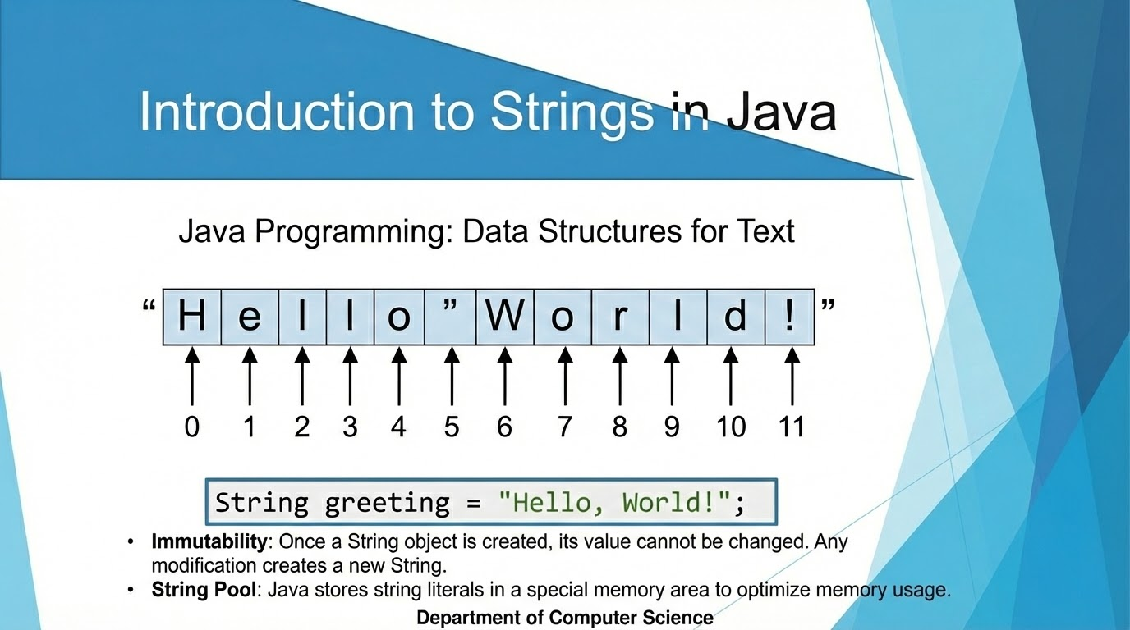

Slide 3
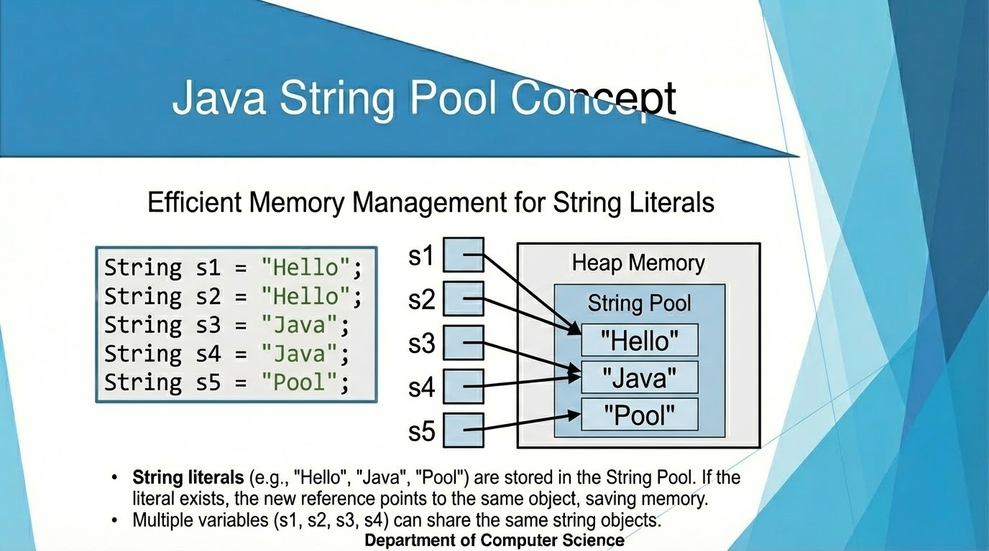

Slide 4
Feature | String | StringBuilder | StringBuffer
Mutability | Immutable (Unmodifiable) | Mutable (Fast) | Mutable (Thread-safe)
Declaration | String s = "Hello"; | StringBuilder sb = new StringBuilder("Hello"); | StringBuffer sb = new StringBuffer("Hello");
Modifications | Creates new objects | Same object changes | Same object changes
Thread Safety | N/A | Not synchronized | Synchronized
Performance | Slower due to new objects | Faster | Slightly slower
Use Cases | Immutable text | Single-threaded applications | Multi-threaded applications
Example | String s = "Hello";s += "World"; | StringBuilder sb = new StringBuilder("Hello");sb.append("World"); | StringBuffer sb = new StringBuffer("Hello");sb.append("World");

Slide 5
Method | Description | Example
length() | Returns the length of the string. | String s = "Hello";int len = s.length(); // 5
charAt() | Returns the character at a given index. | char ch = s.charAt(1); // 'e'
substring() | Extracts a substring from the string. | String sub = s.substring(1, 4); // "ell"
equals() | Compares the string to another string (case-sensitive). | s.equals("Hello"); // true
contains() | Checks if the string contains a sequence. | s.contains("ell"); // true
toUpperCase() | Converts the string to uppercase. | s.toUpperCase(); // "HELLO"
toLowerCase() | Converts the string to lowercase. | s.toLowerCase(); // "hello"
replace() | Replaces occurrences of a character or substring. | s.replace('H', 'J'); // "Jello"

Slide 6
Method | Description | Example
split() | Splits a string into an array of substrings based on a given regex or character. | String str = "apple,banana,orange";String[] parts = str.split(",");// ["apple", "banana", "orange"]
trim() | Removes whitespaces from the beginning and end of the string. | String str = " Hello World ";String trimmed = str.trim(); // "Hello World"
indexOf() | Returns the index of the first occurrence of a character/substring. Returns -1 if not found. | String str = "Hello World";int index = str.indexOf('o'); // 4
lastIndexOf() | Returns the index of the last occurrence of a character/substring. Returns -1 if not found. | String str = "Hello World";int index = str.lastIndexOf('l'); // 9

Slide 7
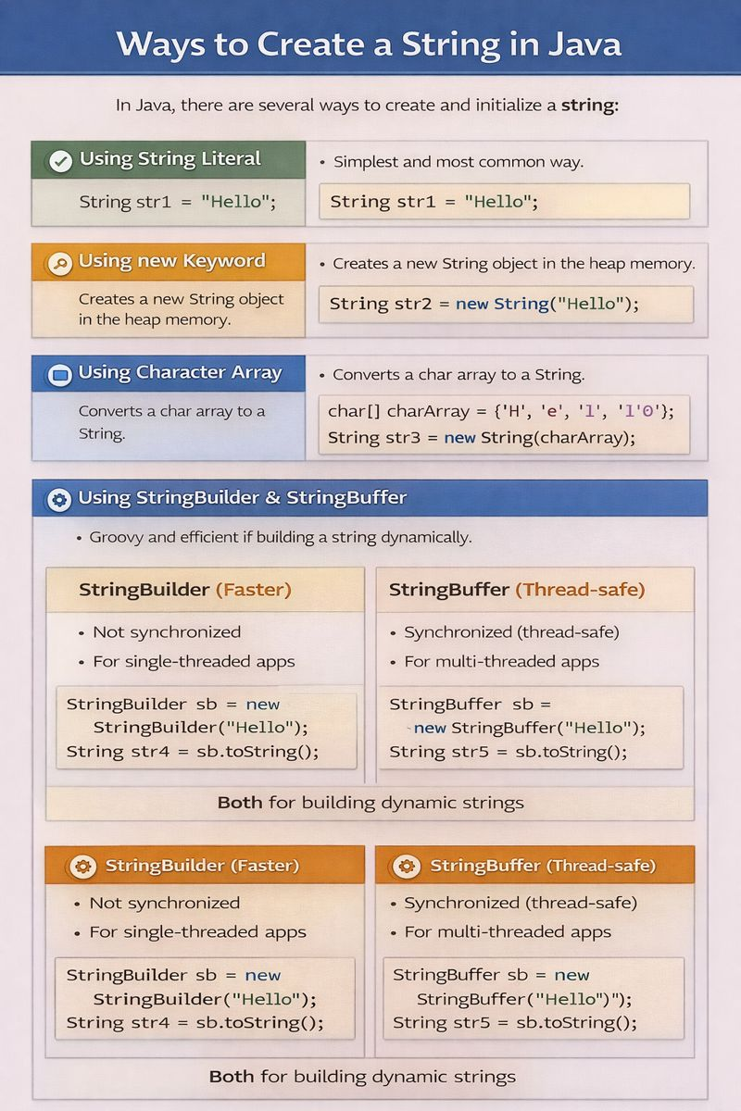

Slide 8
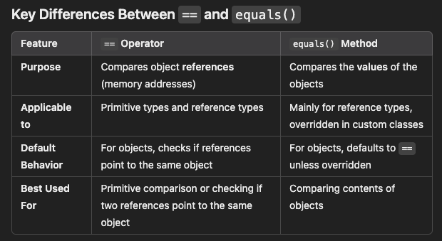

Slide 9
class EqualityDemo {
public static void main(String[] args) {
String s1 = new String("Java");
String s2 = new String("Java");
String s3 = s1;
System.out.println(s1 == s2);
System.out.println(s1.equals(s2));
System.out.println(s1 == s3);
System.out.println(s1.equals(s3));
}
}

Slide 10
Reverse a String
public class ReverseString { public static void main(String[] args) { String str = "hello"; String rev = ""; for (int i = str.length() - 1; i >= 0; i--) { rev += str.charAt(i); } System.out.println(rev); } }

Slide 11
Check if given string is palindrome
public class PalindromeString { public static void main(String[] args) { String str = "madam"; String rev = ""; for (int i = str.length() - 1; i >= 0; i--) { rev += str.charAt(i);} if (str.equals(rev)) System.out.println("Palindrome"); else System.out.println("Not Palindrome"); } }

Slide 12
Count the number of vowels and consonants in string
public class CountVowelsCharacters { public static void main(String[] args) { String str = "education"; int vowels = 0,consonants=0; for (int i = 0; i < str.length(); i++) { char ch = str.charAt(i); if (ch=='a'||ch=='e'||ch=='i'||ch=='o'||ch=='u') vowels++; else consonants++; } System.out.println("Vowels = " + vowels); System.out.println("Consonants = " + consonants); }}

Slide 13
Check if given string is anagram
import java.util.Arrays; public class AnagramCheck { public static void main(String[] args) { String s1 = "listen"; String s2 = "silent"; char[] a1 = s1.toCharArray(); char[] a2 = s2.toCharArray(); Arrays.sort(a1); Arrays.sort(a2); if (Arrays.equals(a1, a2)) System.out.println("Anagram"); else System.out.println("Not Anagram"); }}

Slide 14
Check whether the characters of a string can be rearranged to form a palindrome.
class PalindromeRearrange { public static void main(String[] args) { String s = "aabb"; int[] freq = new int[26]; for (int i = 0; i < s.length(); i++) { freq[s.charAt(i) - 'a']++; } int oddCount = 0; for (int f : freq) { if (f % 2 != 0) oddCount++; } System.out.println(oddCount <= 1 ? "Yes" : "No"); } }
Important Palindrome Rule
A string can form a palindrome if:
✔ All characters appear even number of times
✔ Only one character is allowed to appear odd number of times

Slide 15
Count the duplicate characters in string
public class DuplicateCharacters { public static void main(String[] args) { String str = "programming"; int dcount=0; for (int i = 0; i < str.length(); i++) { int count = 1; for (int j = i + 1; j < str.length(); j++) { if (str.charAt(i) == str.charAt(j)) { count++; } } if (count > 1 && str.indexOf(str.charAt(i)) == i){ dcount++; System.out.println(str.charAt(i));} } System.out.println(dcount) }}

Slide 16
Remove the duplicate characters in string
public class RemoveDuplicateCharsSimple { public static void main(String[] args) { String str = "programming"; String result = ""; for (int i = 0; i < str.length(); i++) { char ch = str.charAt(i); boolean duplicate = false; for (int j = 0; j < result.length(); j++) { if (ch == result.charAt(j)) { duplicate = true; break; } } if (!duplicate) result += ch; } System.out.println(result); }}

